Slide 1
Veeva CLM Visibility Manager (V-CVM)
Carol Jacobson,
Murugesh Naidu

Slide 2
Agenda
Business Requirement
Background & Technical considerations
Proposed solution – Introducing CLM Visibility Manager!
Early Adopters
Questions

Slide 3
Background & Technical Considerations
CLM Presentation Objects have a Private OWD setting (in subject orgs) which means no one except the Owner has access to these at the outset
For groups with a pre-defined list of CLM Presentations, static Sharing rules will share CLM Presentations with groups based on business-defined criteria
For groups/users needing access to ALL presentations with the option for end users to have the ability to choose their specific visibilities to presentations, Veeva CLM Visibility Manager can be leveraged
Initial analysis indicates that this tool would satisfy an open requirement at Janssen. This requirement is also in existence for an upcoming project for BI (MSLs)

Slide 4
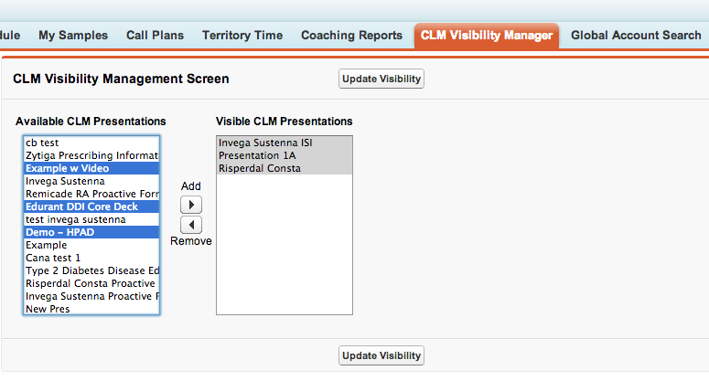
Veeva CLM Visibility Manager (V-CVM)

Slide 5
V-CVM Operational Overview
STEP1: Online, Users navigate to the V-CVM tab and choose the CLM Presentations they wish to see on (can use the embedded SAFARI browser in iRep to Go Online, however experience is different)
STEP 2: On iRep, Users navigate to Options → Database → Refresh Database
STEP 3: Access the Media via the Media button on iRep. They should now see the updated CLM content based on their selections in V-CVM

Slide 6
Veeva CLM Visibility Manager (V-CVM)
V-CVM provides the ability to a user to see their current state of visibility for CLM presentations and update it according to their specific field use needs
It manifests itself as a simple Salesforce Visualforce tab
Users having access to this tab and the Visualforce page will have access to this functionality
Access to V-CVM can either be provided at a Profile level or an individual level (using a Permission Set)
V-CVM changes the Sharing structure of one or more CLM Presentations online only – users must refresh database on iRep (until enhanced Sync is available) to effect changes offline

Slide 7
Veeva CLM Visibility Manager (V-CVM)
V-CVM is custom Visualforce and Apex development effort
OWD for CLM Presentations cannot be Public Read/Write
Estimated LOE is about 40-60 hours for DTDD (Dev, Test, Document, Deploy) of the base solution as described in previous slides
V-CVM can be further customized based on final business requirements (for eg: specify a criteria using config to make only certain CLM presentations available rather than all; send out notifications to admin etc)

Slide 8
Questions??

